Slide 1
Arrays and Loops
Front-End Web Development

Slide 2
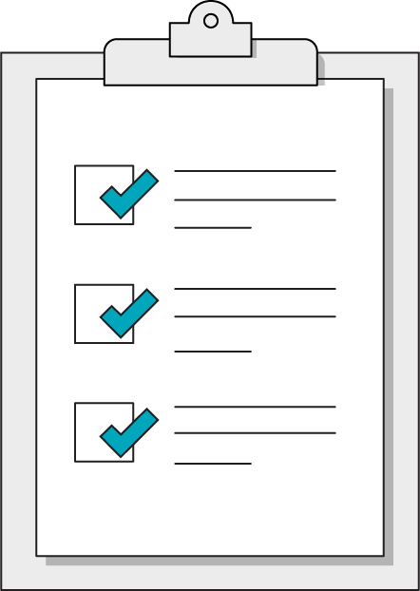
Today’s Learning Objectives
In this lesson, you will:
Use arrays and loops in JavaScript to manage collections of data.
Invoke array methods to manipulate the contents of an array.
Distinguish between for loops and while loops.
‹#› | © 2020 General Assembly

Slide 3
Arrays
Think of arrays as containers of data, structured like a list. Technically, an array is an ordered collection of data types combined into one variable.
Each item in an array is assigned an index value based on its position. These index values allow us to access individual elements within the array.
["banana", "orange", "apple"]
0
1
2

Slide 4
Syntax
const fruits = ["banana", "orange", "apple"]
You make an array using a set of square brackets.
Inside the brackets, each value must be separated by a comma.
Arrays can contain, strings, numbers, booleans, objects or any of these combined.

Slide 5
Why Do Arrays Matter?
Arrays are one of just two types of data “containers” in JavaScript (the other is objects). As a result, much of the data we use comes in the form of arrays.
Arrays come from three main places:
The DOM (with querySelectorAll and getElementsByClassName)
API responses (information received from other web applications)
Databases

Slide 6
Accessing Array Values
const fruits = ["banana", "orange", "apple"];
fruits[0]; // will output "banana"
fruits[1]; // will output "orange"
fruits[2]; // will output "apple"
Access array items using square brackets around their index values. It’s pretty simple — just remember that the first index value is always zero!

Slide 7
Array Properties and Methods
Front-End Web Development

Slide 8
.indexOf()
const fruits = ["banana", "orange", "apple"];
fruits.indexOf("orange");
// will return the number 1
Use .indexOf() to see the index value of any item in the array.

Slide 9
.length
const fruits = ["banana", "orange", "apple"];
fruits.length;
=> 3
Use the .length property to figure out how many items are in your array. This is very useful when we need to look through the whole array with a loop.

Slide 10
Adding an item .push()
const fruits = ["orange"];
fruits.push("kiwi");
// fruits is now: ["orange", "kiwi"];
The .push method adds the item inside the parentheses to the end of the array.

Slide 11
Removing an item .pop()
const fruits = ["banana", "orange", "apple"];
fruits.pop();
// fruits is now: ["banana", "orange"];
The .pop method removes the last item in the array. Can you hear the sound effect when you pop an item off?

Slide 12
Adding an item .unshift()
const fruits = ["orange", "kiwi"];
fruits.unshift("cherry");
// fruits is now: ["cherry", "orange", "kiwi"];
The .unshift method adds the item inside the parentheses to the beginning of the array.

Slide 13
Removing an item .shift()
const fruits = ["banana", "orange"];
fruits.shift();
// fruits is now: ["orange"];
The .shift method removes the first item in the array. This one just quietly shifts off into the night.

Slide 14
Adding specific items .splice()
fruits = ["cherry", "kiwi"];
fruits.splice(1, 0, "pear");
// 1st value = index value for splice
// 2nd value = number of items to remove
// 3rd value = item to be added to array
// fruits is now: ["cherry", "pear", "kiwi"];
If you use a third value in the .splice method, it will add that value into your array at the location indicated by the first value.

Slide 15
Removing specific items .splice()
const fruits = ["cherry", "orange", "kiwi"];
fruits.splice(1,1);
// fruits is now: ["cherry", "kiwi"];
The .splice method removes specific items from the array.
The first number indicates the index where removal begins, and the second number indicates the total number of items to remove.

Slide 16
.reverse() the order of elements
const fruits = ["cherry", "pear", "kiwi"];
const fruits.reverse();
// fruits is now: ["kiwi", "pear", "cherry"];
True to its name, the .reverse method reverses the order of all items in the array. It doesn't add or delete anything.

Slide 17
.join() all elements together
const fruits = ["kiwi", "pear", "cherry"];
const fruitsList = fruits.join(" and ");
// fruitsList is: "kiwi and pear and cherry";
.join combines all the items in the array together into a string. If given a string as a parameter, .join will place the given string in between the elements.

Slide 18
Multi-Dimensional Arrays (Matrix)
const produce = [["kiwi", "pear"], ["carrots", "celery"]];
// produce[1] is: ["carrots”, “celery”];
// produce[0][1] is: "pear";
You can even put arrays inside of arrays! Access two-dimensional arrays using a second set of square brackets: The first brackets locate your desired array, and the second brackets locate the item within that array.

Slide 19
Array Methods
Try out your new array methods and properties:
Reference code:
https://drive.google.com/drive/folders/19GlwseIAqAmpggnMHaUE-xHicKflmsyl?usp=sharing
‹#› | © 2020 General Assembly

Slide 20
Loops
Front-End Web Development

Slide 21
Loop: A control flow statement allowing for the repeated execution of a code block until a specific condition is reached.
‹#› | © 2020 General Assembly

Slide 22
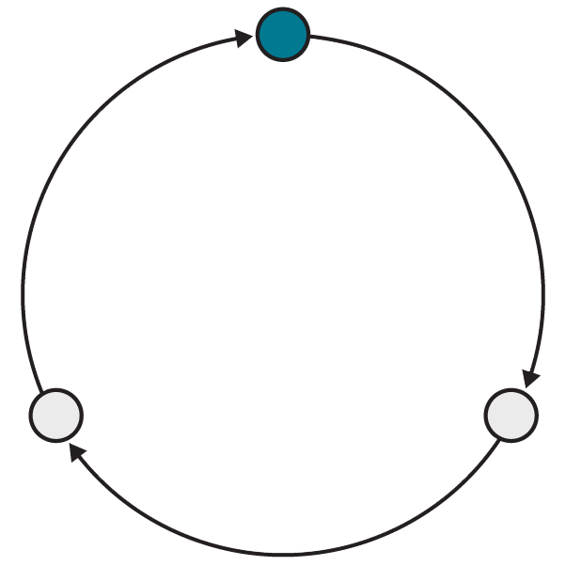
Why Loops?
Loops take advantage of what computers do best: evaluate instructions across organized sets of data very quickly.
Computers excel when working in isolated patterns, which is exactly how a loop works.
Avoid needlessly copying or re-typing code by repeating it in a loop.

Slide 23
An Iterator, Terminator, and Incrementer Walk Into a Loop...
A for loop is similar to an if statement but with more conditions. When creating a for loop, we need to make three declarations:
Define a starting variable to act as the iterator, typically named i.
Establish a condition for the loop to stop, called the terminating condition.
Increment the iterator variable (or decrement, if the loop goes backward).
for (let i = 0; i < 10; i++) {
console.log(i);
}
// outputs 0,1,2,3,4,5,6,7,8,9

Slide 24
Loops + Arrays: A Classic Combination
Front-End Web Development

Slide 25
for Loop + Arrays
Notice the highlighted terminating condition. The array's length limits the number of loops.
const myArray = ["John", "Benjamin", "Victor", "Serrao"];
for (let i = 0; i < myArray.length; i++) {
console.log(myArray[i]);
}
// outputs each name in the list, one at a time

Slide 26
while Loop
The while loop, a simpler cousin of the for loop, will run as long as a condition remains true.
const myArray = ["John", "Benjamin", "Victor", "Serrao"];
let i = 0;
while (i <= myArray.length) {
// code to repeat
i++;
}

Slide 27
Array method .forEach()
The array method forEach() performs a specific function for each of the items in an array. No need for an iterator or a limit.
const myArray = ["John", "Benjamin", "Victor", "Serrao"];
myArray.forEach(function(name) {
console.log(name);
})
// outputs each name in the list, one at a time

Slide 28
for vs. while Loops
These loops seem so similar — which one should you choose? Most of the time, the answer is a for loop.
for loops are perfect for when you have a specific number of times you need the loop to run. In most cases, that number is the length of an array.
A while loop is useful when there’s no way of knowing how many times the loop will need to repeat — like a game loop that stops when a character dies.

Slide 29
Arrays and Loops Examples
We can see an interactive version of these examples, along with a very different way to perform DOM manipulations:
Reference code:
https://drive.google.com/drive/folders/19GlwseIAqAmpggnMHaUE-xHicKflmsyl?usp=sharing
‹#› | © 2020 General Assembly

Slide 30
Array and Loop Exercises
The following exercises demonstrate how loops can be used to display lists of information:
Reference code:
https://drive.google.com/drive/folders/19GlwseIAqAmpggnMHaUE-xHicKflmsyl?usp=sharing
‹#› | © 2020 General Assembly

Slide 31
Key Takeaways
For Next Time
Use Loops to Handle Arrays
Forms
Arrays can contain any amount of any data type.
Loops create dynamic, DRY code for iterating.
Use for loops for a specific number of iterations and while loops for unknown quantities.
We’ll use forms to collect data from users, validate the information they submit, and display error messages where they have submitted invalid values.
‹#› | © 2020 General Assembly

